Slide 1



Data Informed Adaptive Management in Agriculture
Paul Hegedus
Bruce Maxwell
https://paulhegedus.github.io/ESA20/

Slide 2
Environmental and economic effects of agriculture
Increasing population, less cultivated land
Input centric systems
$109 per acre spent on fertilizer (Schnitkey 2017)
114 lbs per acre applied globally (World Bank 2015)
215% increase in fertilizer applied from 1960 to 2004 (EPA 2018)
For every 2000 lbs of fertilizer applied, 1200 lbs unused by crop (Fischer 2017)
Under the above assumptions $71.14 per acre wasted
Qualman 2018

Slide 3
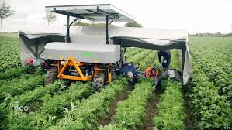
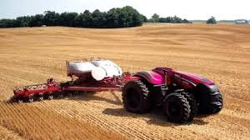
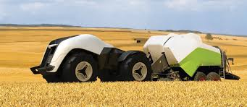
Deskilling of the rural workforce (Carlisle et al. 2019)
6.5 million farms in the USA in the 1920s
2.04 million in 2017
5% of the population work agriculture related jobs
In developed nations
66% in developing nations
Less labor -> Increased automation
Eco India
Proessler 2013
BBC 2015

Slide 4
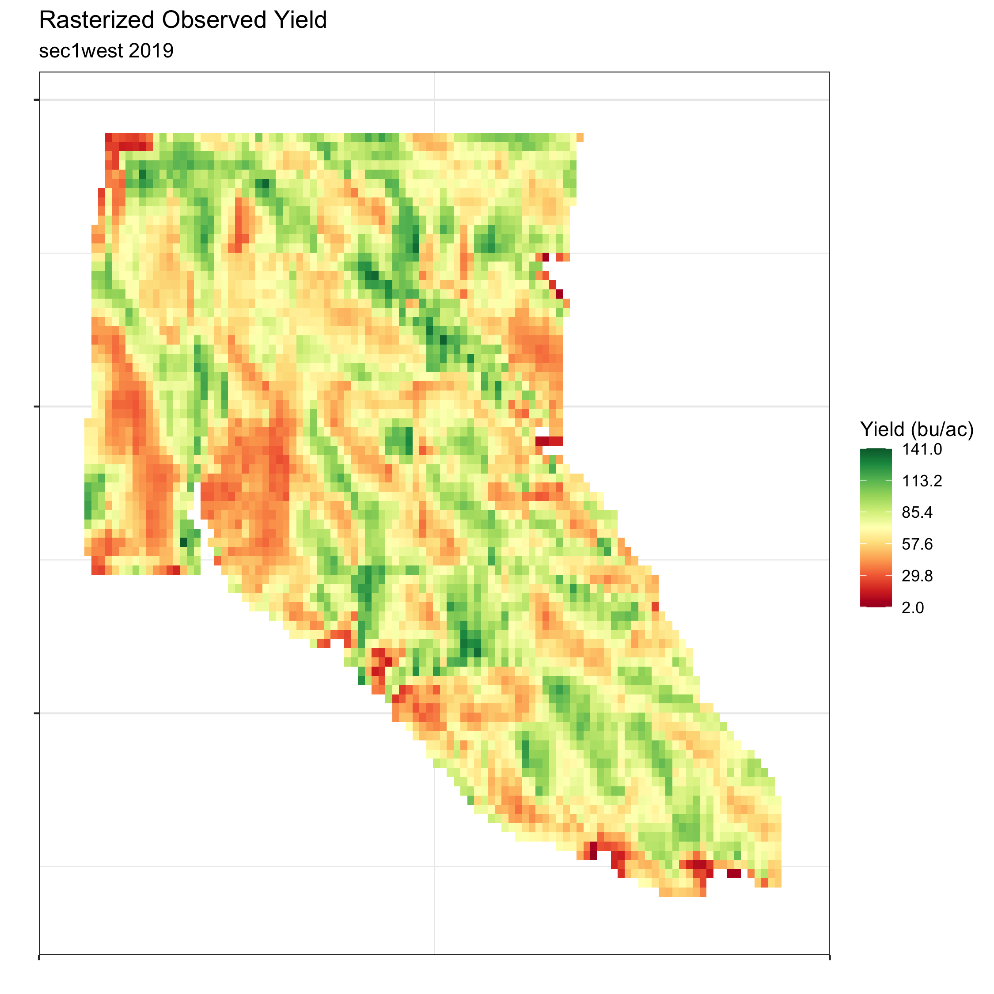
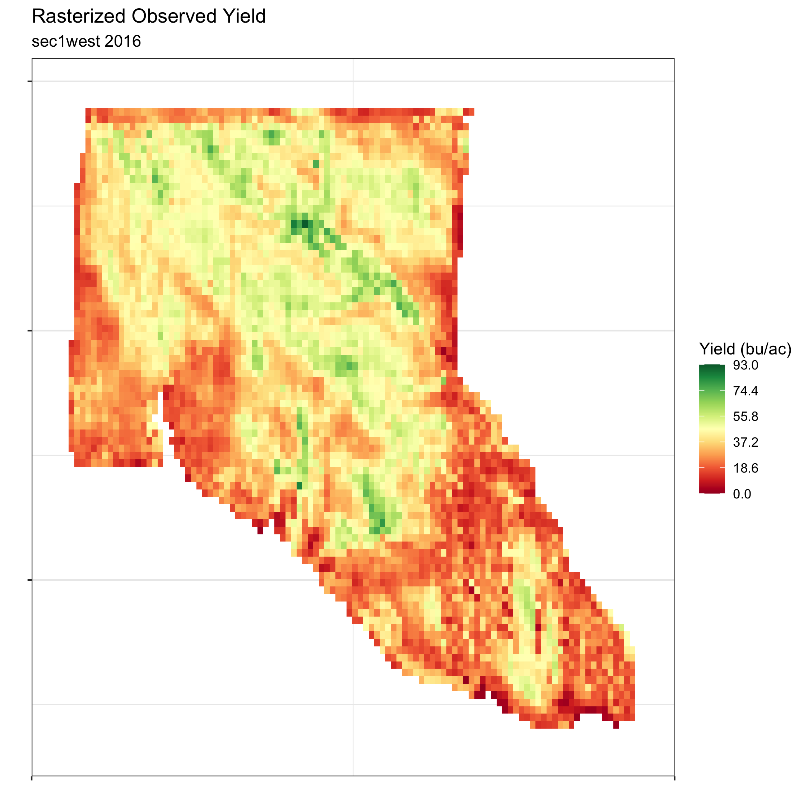
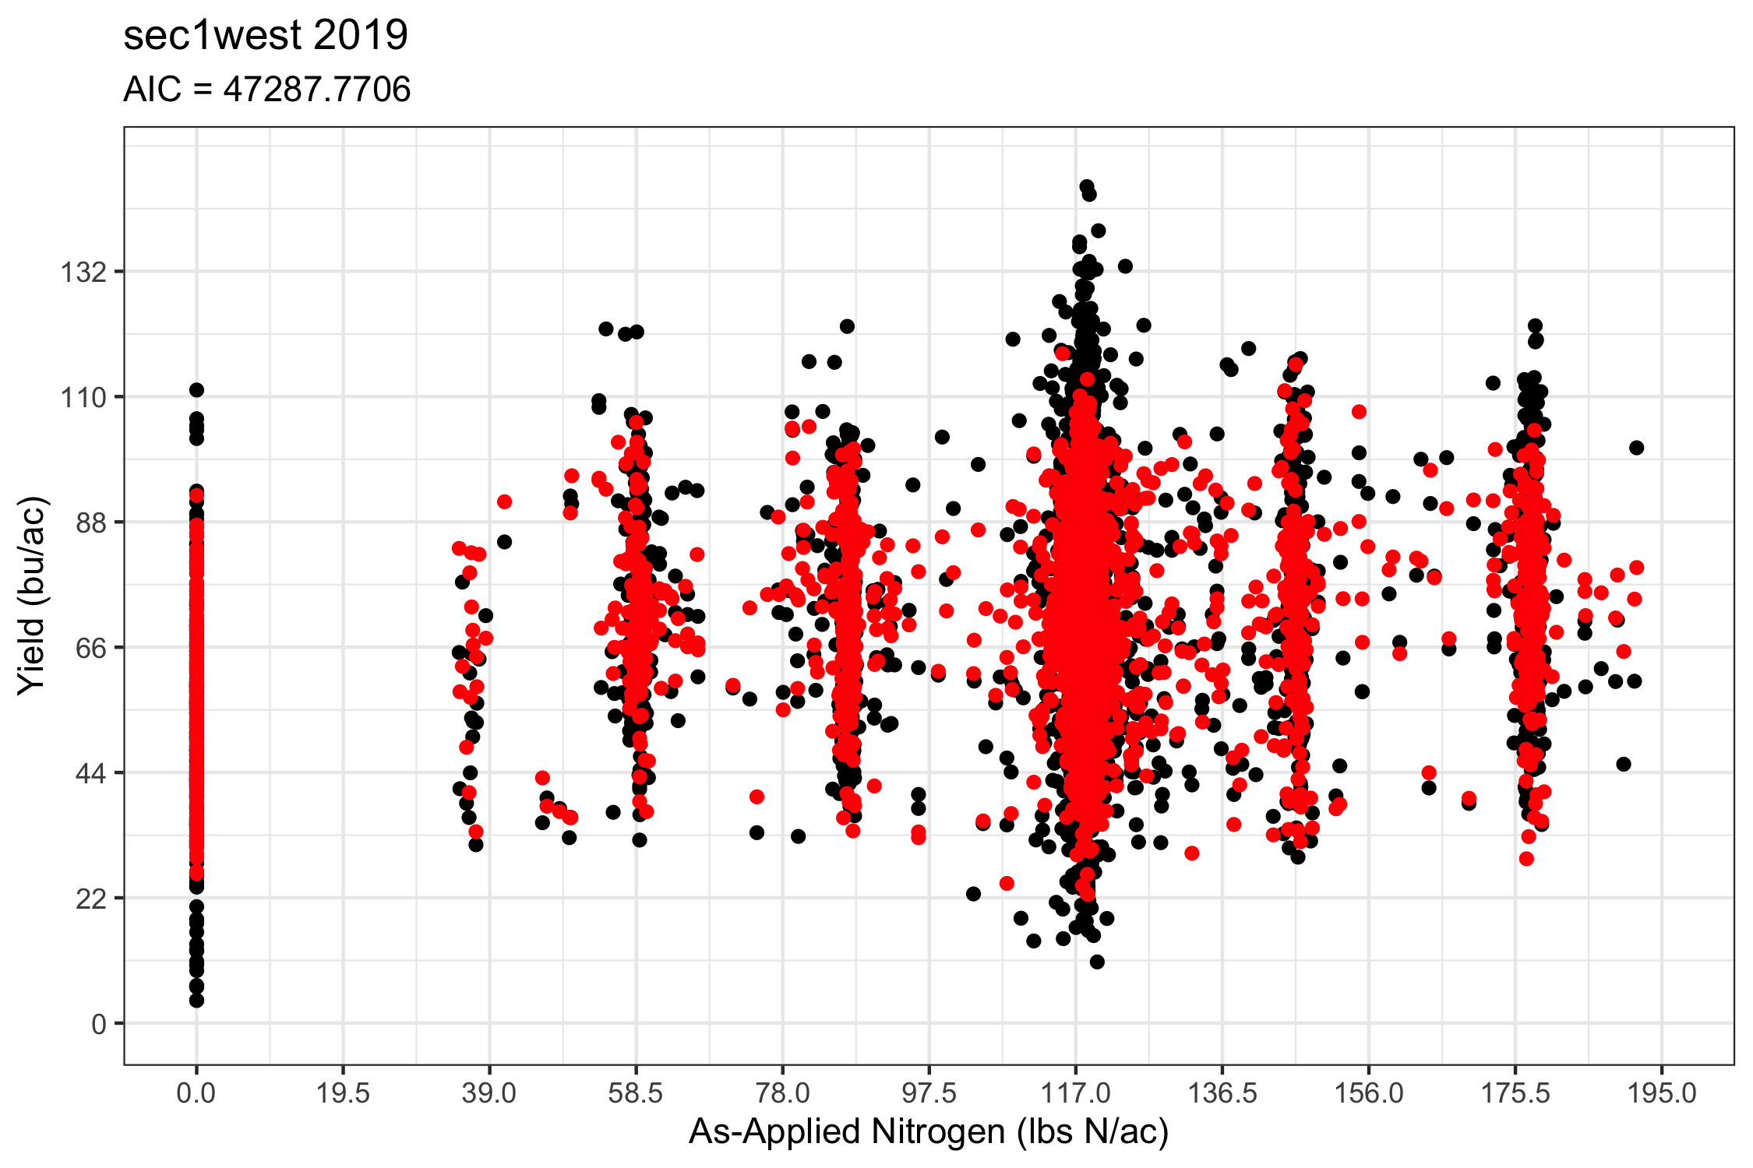
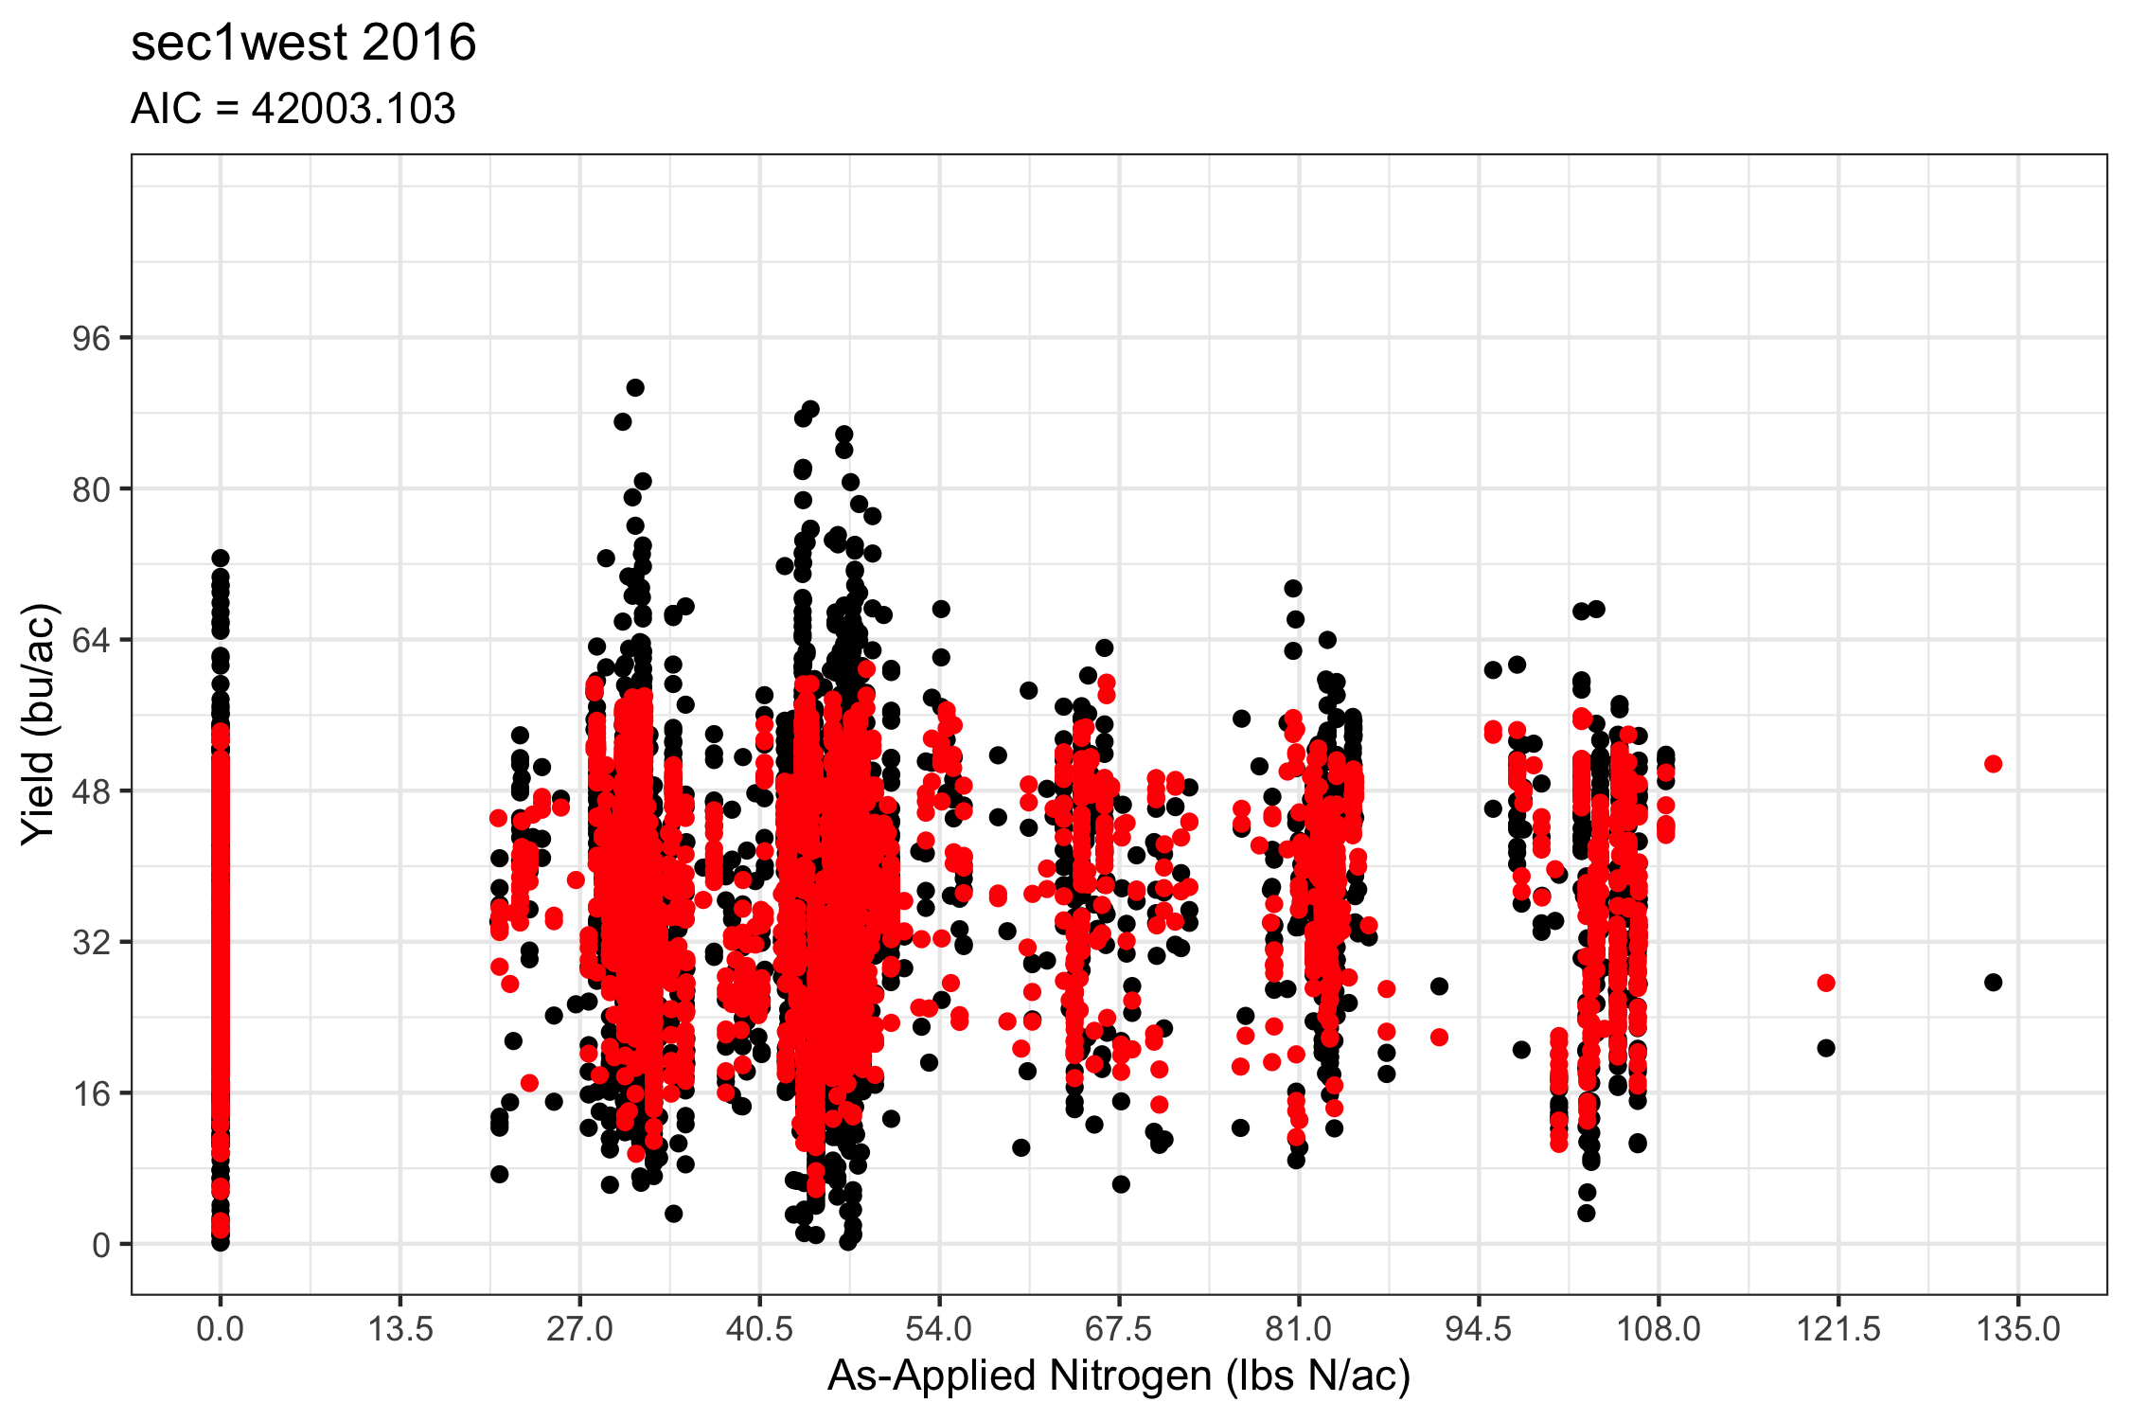
Field specificity
Despite less farmers and more land, we need to be more field specific in our management
Need to understand variation and drivers of crop responses

Slide 5
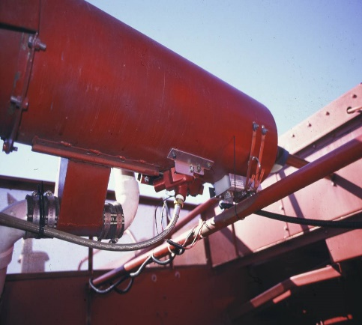
Agricultural Data Revolution
We already have the stream of data to measure field specific responses
Photo: Veris Industries
Photo: American Society of Agronomy
Photo: Iowa State University
Photo: John Long, 2017

Slide 6
Towards sustainable agriculture
“Right input, right amount, right time, and the right place” (Hooi et al. 2008)
Shift towards more sustainable systems
Reduction of inputs
Economic benefits
Sustainability and environmental protection
Notes:
We have data to collect field specific information
And we have the automation and machinery to implement data oriented solutions

Slide 7
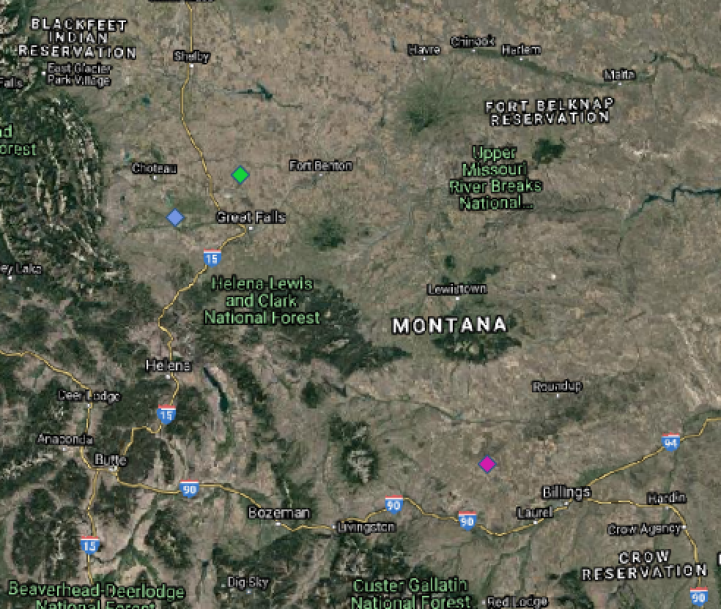
Goal and Objectives
Identify drivers of production (grain yield), quality (grain protein), and net-returns for Northern Great Plains small-grain agroecosystems and evaluates their relatedness and consistency between fields and years.
What are the drivers of production, quality, and net-returns within fields for a given year?
How does this vary for the same field in different years?
How consistent are drivers for fields of the same farm? Same region?
Are the drivers of variation for all fields of a farm consistent for a given year?

Slide 8
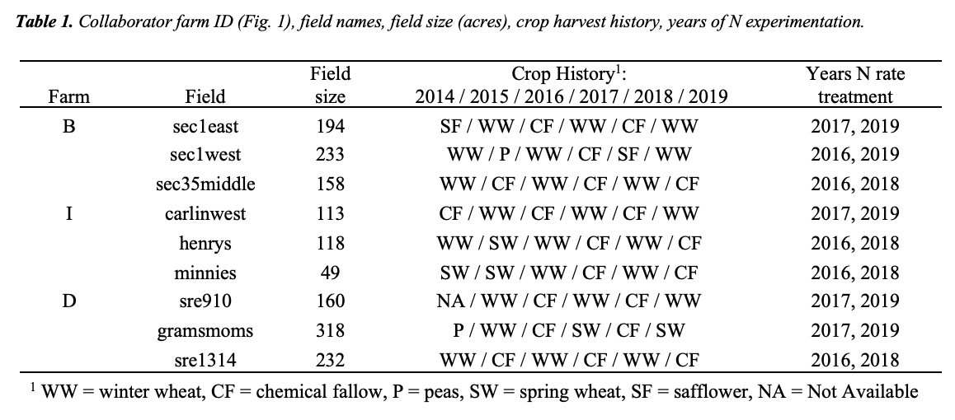
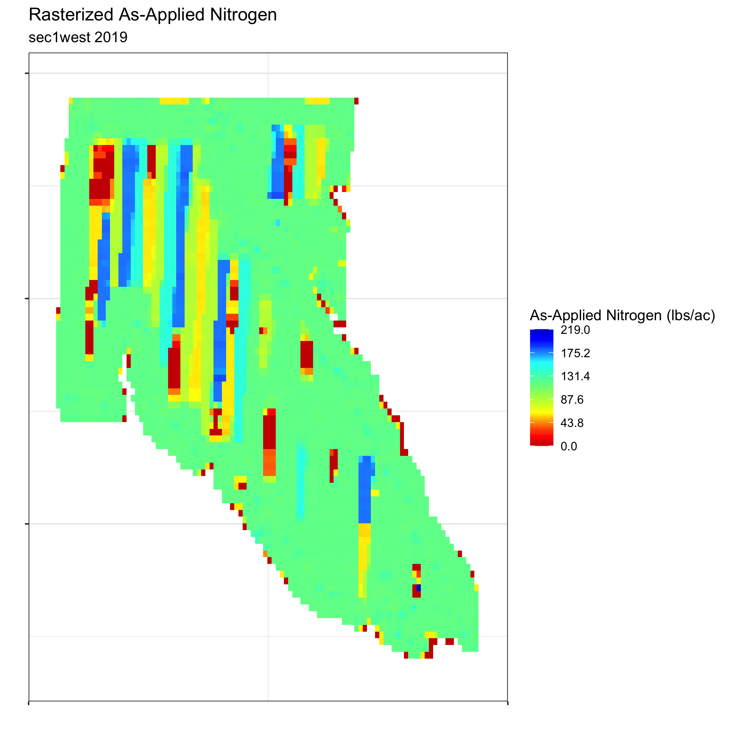
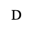
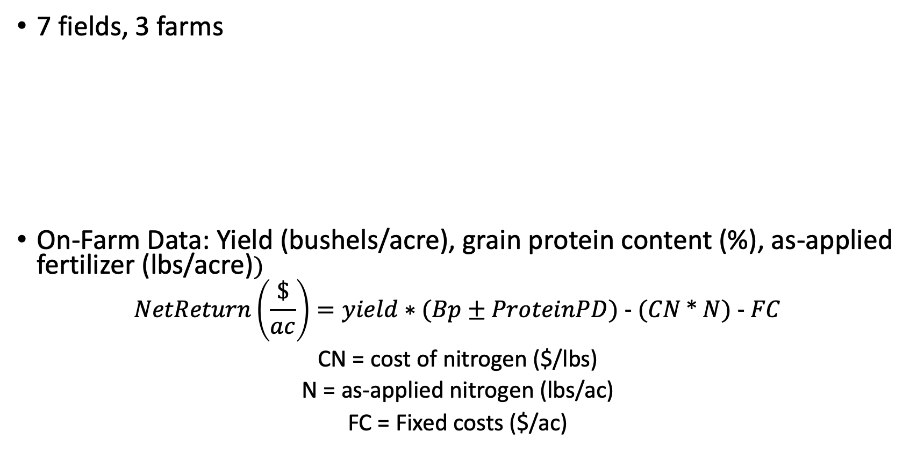
Methods
7 fields, 3 farms
On-Farm Data: Yield (bushels/acre), grain protein content (%), as-applied fertilizer (lbs/acre)$)$
$$NetReturn\left(\frac{\$}{ac}\right)=yield∗(Bp±ProteinPD) - (CN * N) - FC$$
CN = cost of nitrogen ($/lbs)
N = as-applied nitrogen (lbs/ac)
FC = Fixed costs ($/ac)

Slide 9
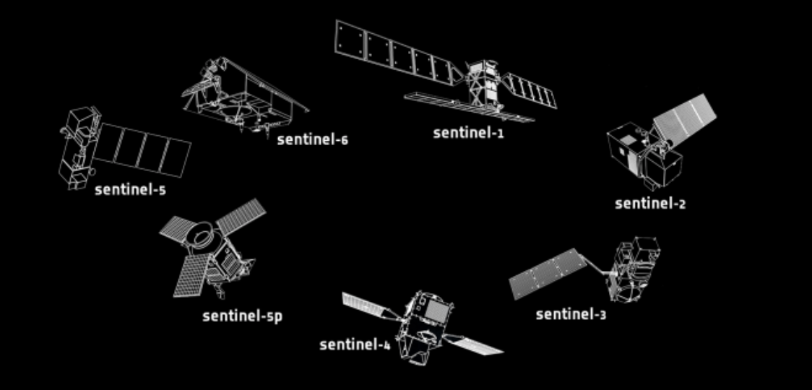
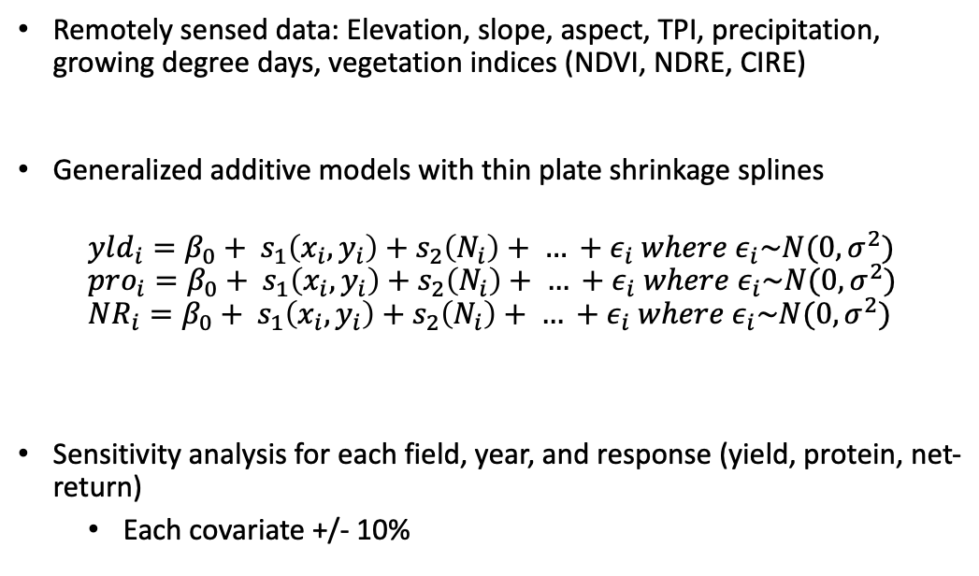
Methods
Remotely sensed data: Elevation, slope, aspect, TPI, precipitation, growing degree days, vegetation indices (NDVI, NDRE, CIRE)
Generalized additive models with thin plate shrinkage splines
$$yld_{i}=β_{0}+ s_{1}\left(x_{i}, y_{i}\right)+s_{2}\left(N_{i}\right)+ … +ε_{i} where ε_{i}\sim N(0,σ^{2})$$
$$pro_{i}=β_{0}+ s_{1}\left(x_{i}, y_{i}\right)+s_{2}\left(N_{i}\right)+ … +ε_{i} where ε_{i}\sim N(0,σ^{2})$$
$$NR_{i}=β_{0}+ s_{1}\left(x_{i}, y_{i}\right)+s_{2}\left(N_{i}\right)+ … +ε_{i} where ε_{i}\sim N(0,σ^{2})$$
Sensitivity analysis for each field, year, and response (yield, protein, net-return)
Each covariate +/- 10%

Slide 10
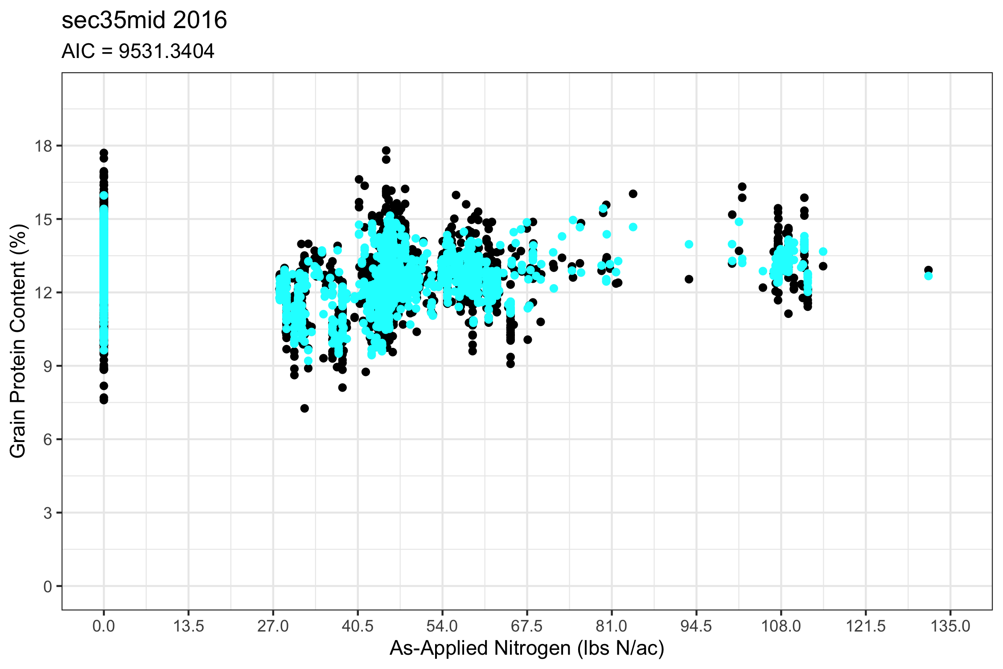
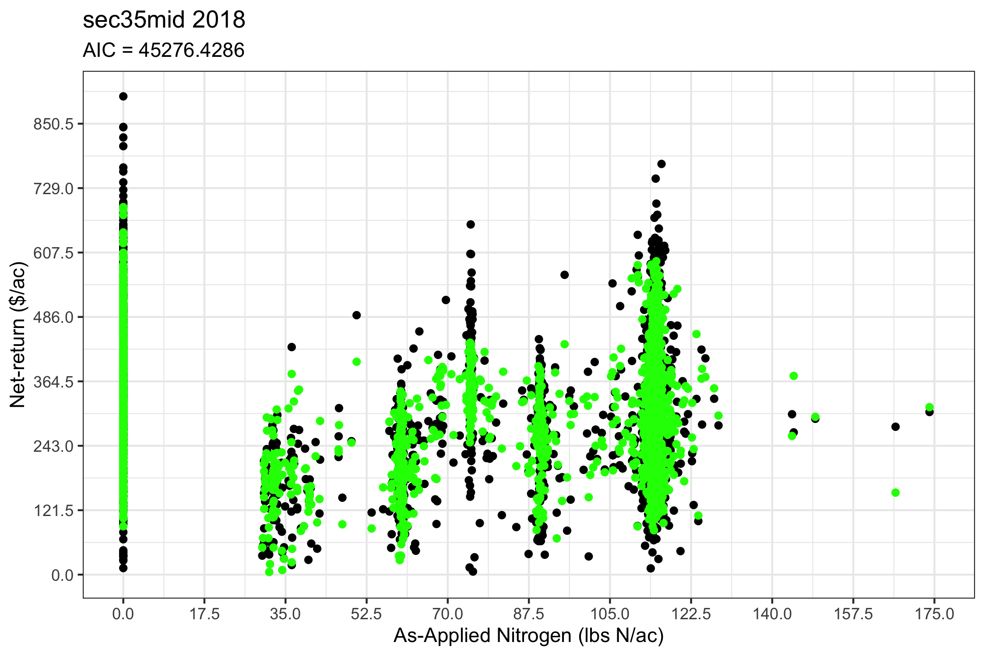
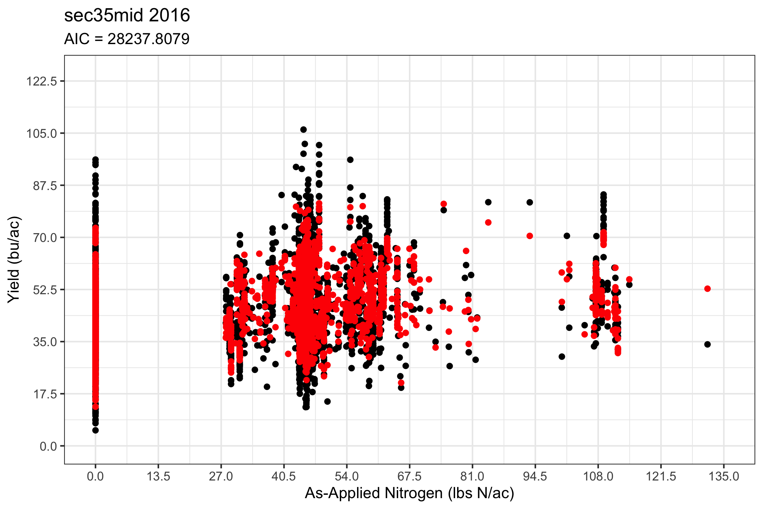
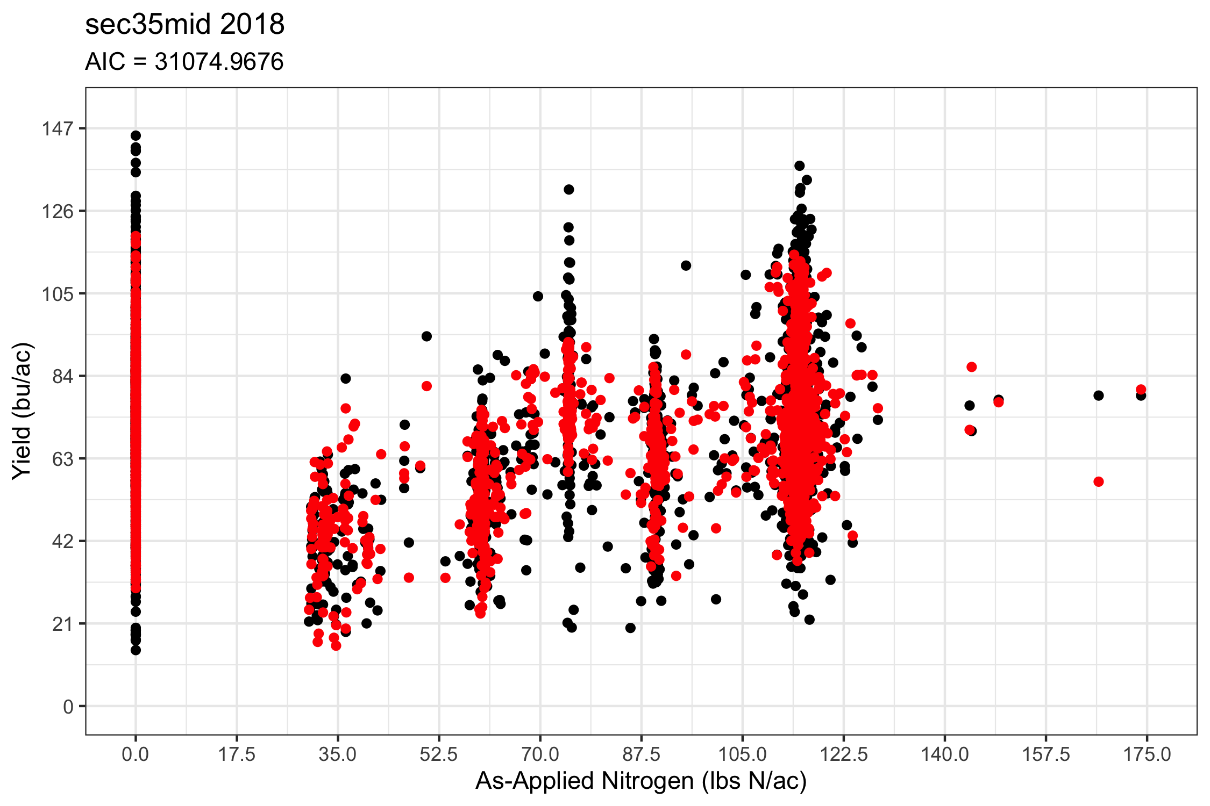
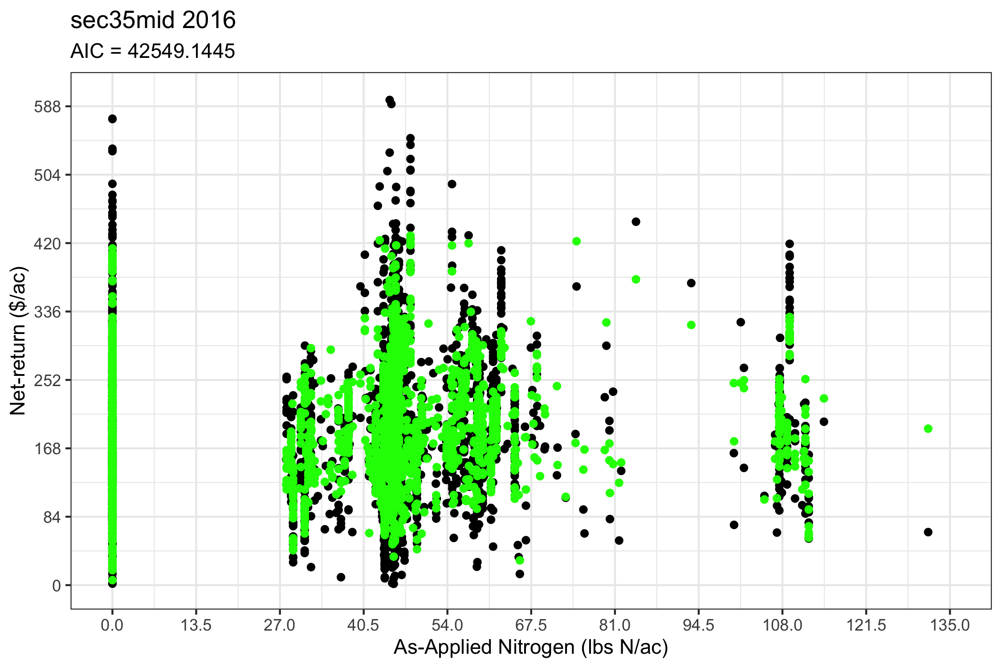
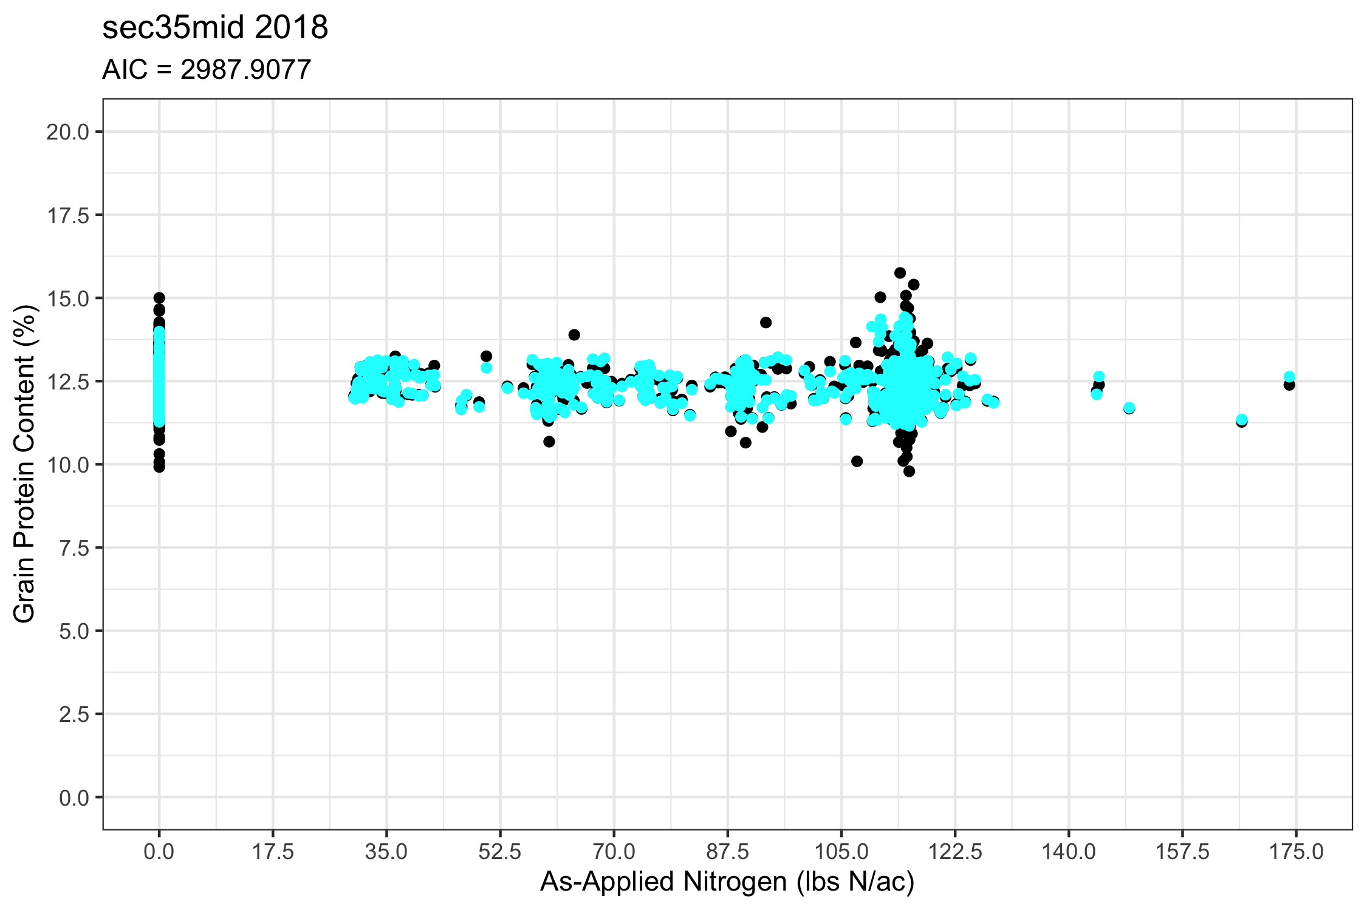
Results
sec1east

Slide 11
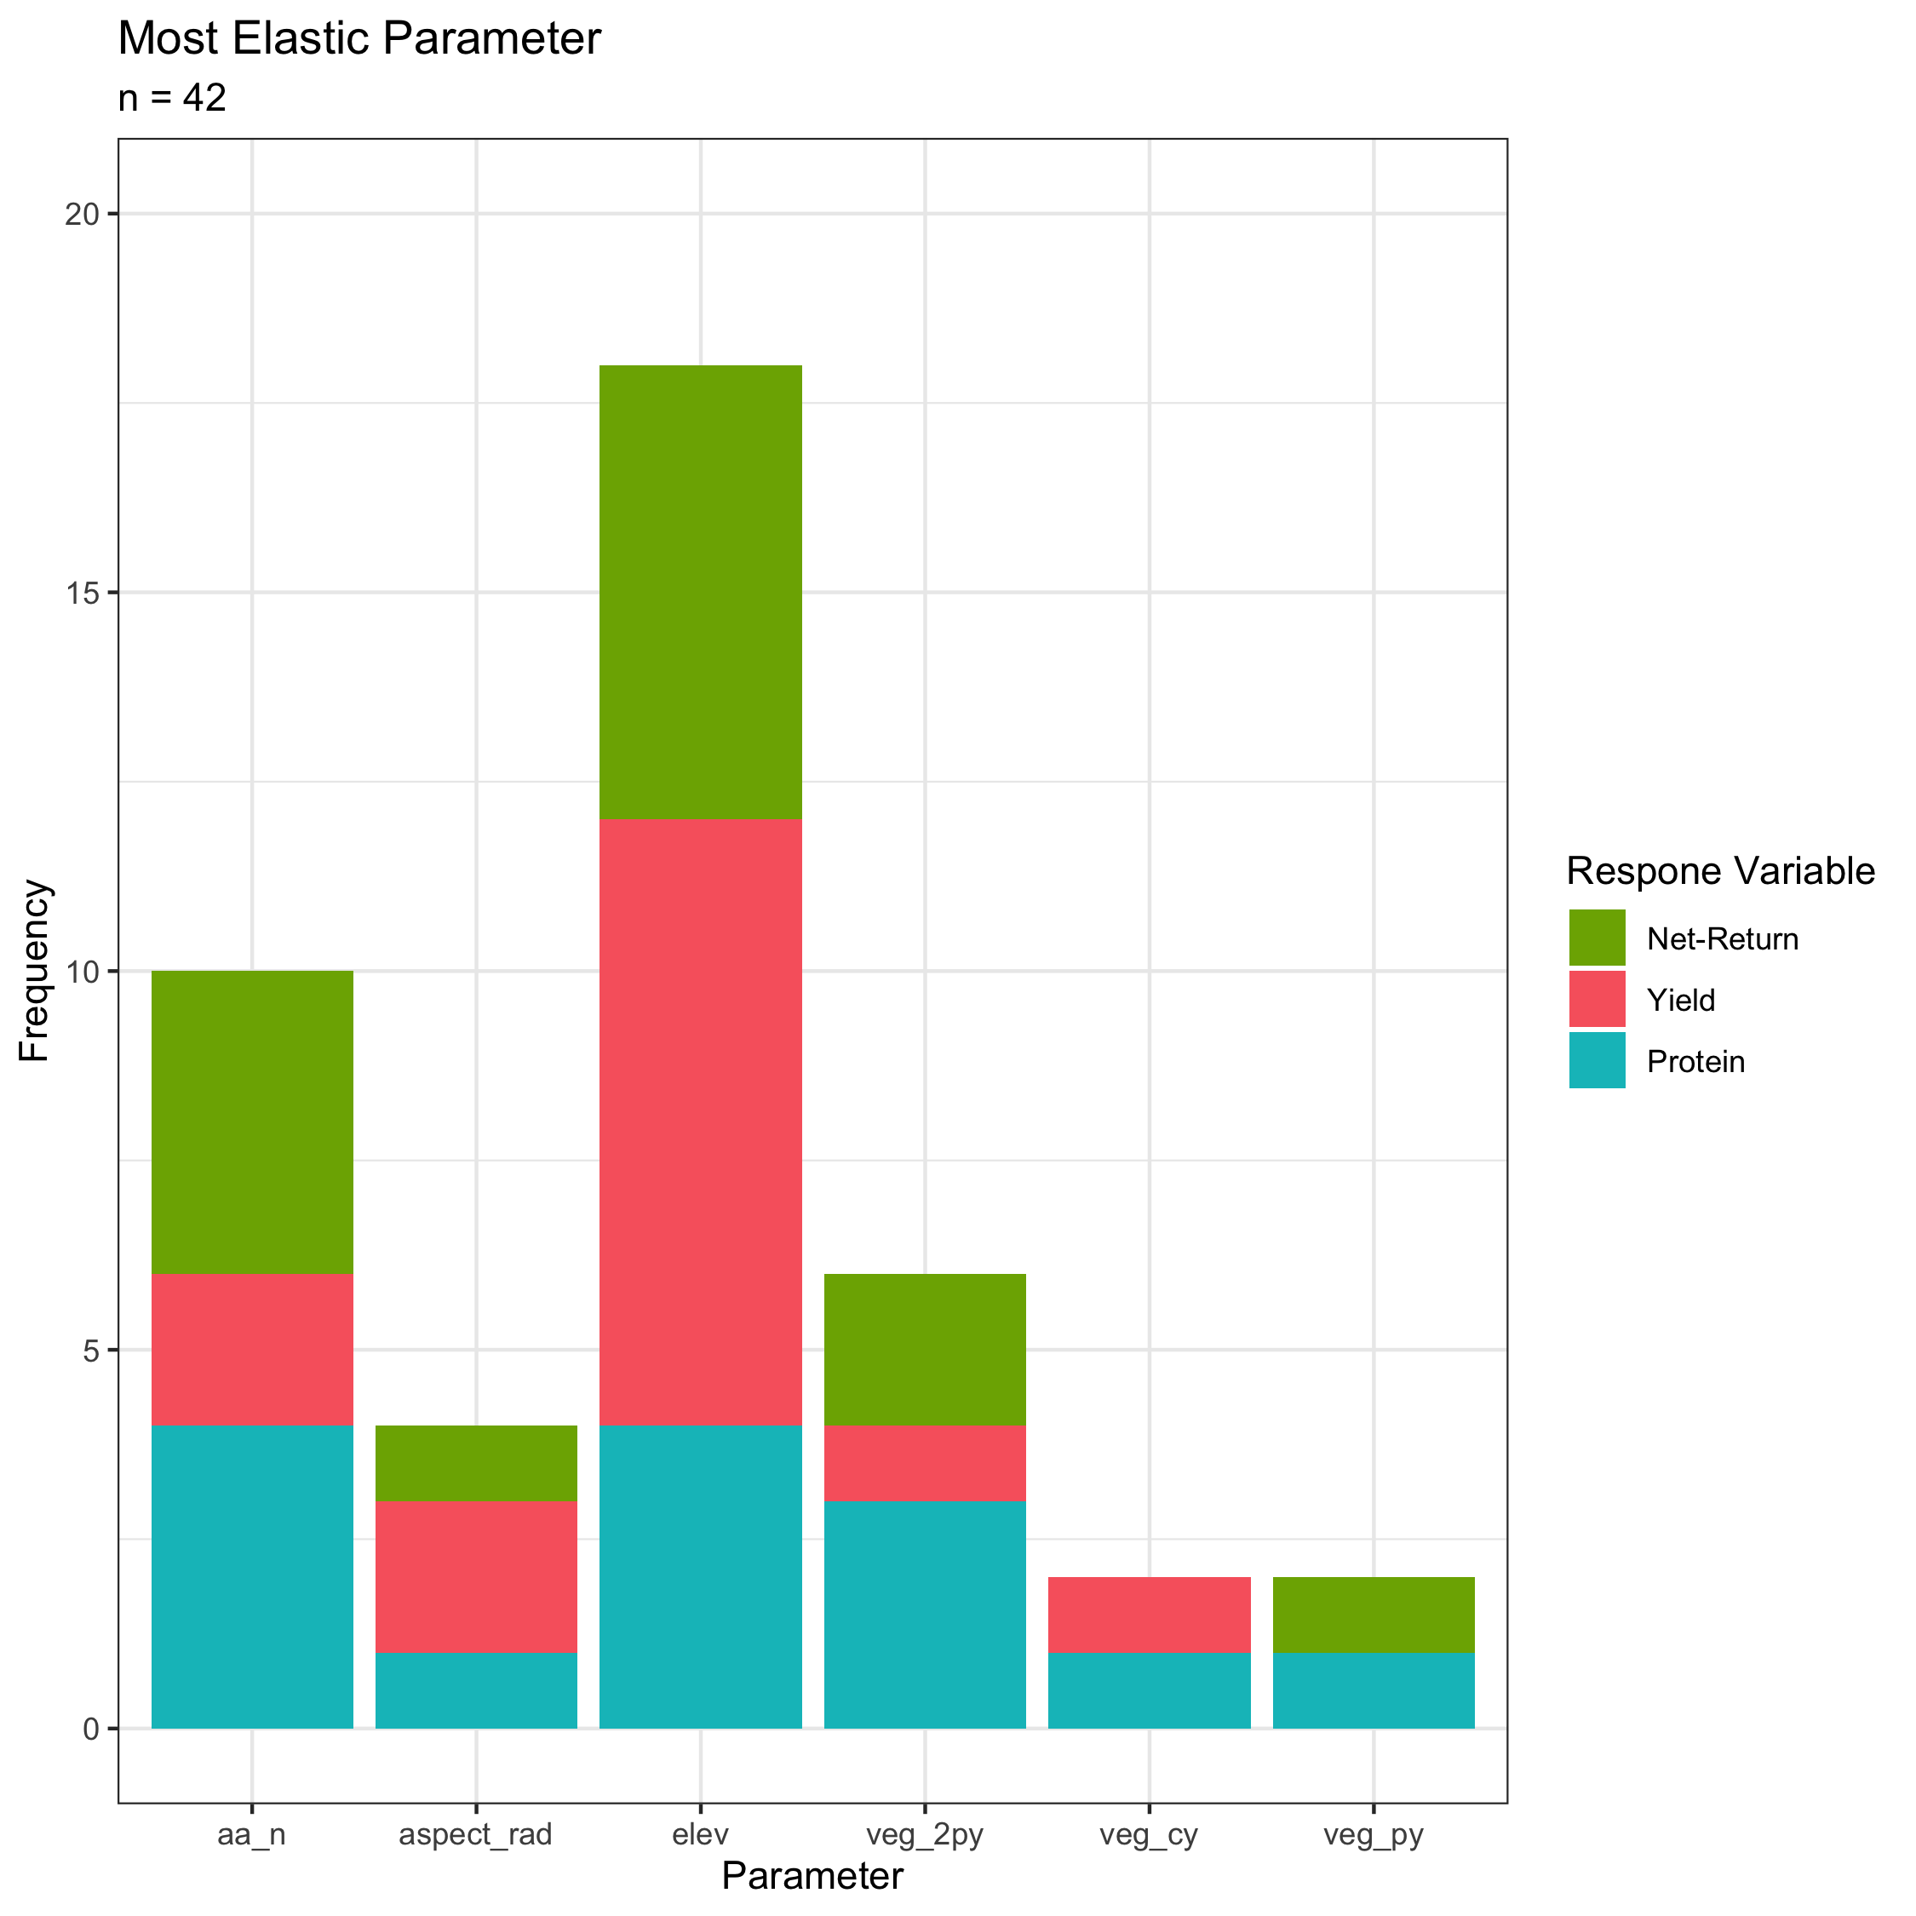
Results
The same covariate was the most elastic for yield, protein, and net-return in 6/14 instances
For each field and year combination
The same covariate was the most elastic in both years of the same field for a given response variable 5/21 instances (unique response var and field)
For each field and response variable (yield or protein or net-return) combination

Slide 12
Conclusions – Field Specificity!
Different drivers for different response variables even in the same field and year
In ~50% of cases, the same covariate was the most influential on yield, protein, and net-return, otherwise, different factors driving each response
Different drivers for responses across fields in the same year (even on same farm)
Even in fields bordering each other, different covariates had the most influence on each response variable in each year (i.e. sec1east & sec1west)
Different drivers most influential on responses across years in the same field
~25% of cases, the same covariate was the most elastic across years, ~75% of the time, different covariate was most influential on the response in the same field in different years
Parameter | Adjustment | MeanResp | Sensitivity.value | Elasticity.value | ResponseVar | field | year
veg_2py | 10 | 66.1846 | 0.2525 | 1 | yld | sec1east | 2017
aspect_rad | -10 | 9.9481 | 0.0234 | 1 | pro | sec1east | 2017
veg_2py | 10 | 229.9256 | 0.3725 | 1 | NR | sec1east | 2017
veg_py | 10 | 80.8975 | 0.0760 | 1 | yld | sec1east | 2019
aspect_rad | 10 | 11.9200 | 0.0176 | 1 | pro | sec1east | 2019
veg_py | 10 | 338.2293 | 0.1122 | 1 | NR | sec1east | 2019
veg_cy | 10 | 35.8959 | 0.0752 | 1 | yld | sec1west | 2016
elev | -10 | 13.6699 | 0.0497 | 1 | pro | sec1west | 2016
elev | -10 | 128.4749 | 0.1701 | 1 | NR | sec1west | 2016
elev | -10 | 72.5541 | 0.1100 | 1 | yld | sec1west | 2019
elev | 10 | 13.0989 | 0.0233 | 1 | pro | sec1west | 2019
elev | -10 | 314.7683 | 0.1459 | 1 | NR | sec1west | 2019
Notes:
NOTE: Price adds uncertainty to net-return because farmer doesn’t know the price they’ll receive. These analyses are if price was fixed.

Slide 13
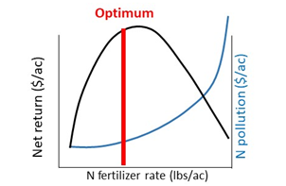
Future Work
How do these drivers influence nitrogen fertilizer management recommendations?
How can we manage agroecosystems based on drivers of production, quality, and net-return?
How to predict what covariates will be most influential in the upcoming year.
Value of N lost ($/ac)

Slide 14



Acknowledgements
The OFPE project was initially funded by the Montana Research and Economic Development Initiative (MREDI) and is continued to be funded by the Montana Fertilizer Advisory Committee (MFAC). Other funding sources include the Montana State University College of Agriculture (MSU CoA), the MSU Department Land Resources and Environmental Sciences (LRES), and the Montana Institute on Ecosystems (MT IoE). Other support and funding has been provided by the Data Intensive Farm Management project at the University of Illinois (DIFM). Funding for Paul Hegedus is provided by MSU and the Graduate Student Grants from the Western Sustainable Agriculture Research and Education (WSARE).

